Slide 1
Lecture 9
Matrix condition number Basics

Slide 2
Introduction
Previously we learned how to quantify errors using vector norms
We could define forward and backward errors as well as the error magnification factor
From the lesson on solving nonlinear equations, we know that problems with high error magnification factor are challenging
Does such problems exist as well for systems of linear equations?
Notes:
In previous lecture we learned how we can use vector norms to quantify errors
We could define forward and backward errors as well as the error magnification factor
Recall that when we studied nonlinear equations we found that there exist problems with very high error magnification factors.
Such problems were very challenging to solve numerically and gave us serious problems to estimate properly errors.
Does such problems exist as well for systems of linear equations?
The answer is unfortunately yes.
The following example will prove this.

Slide 3
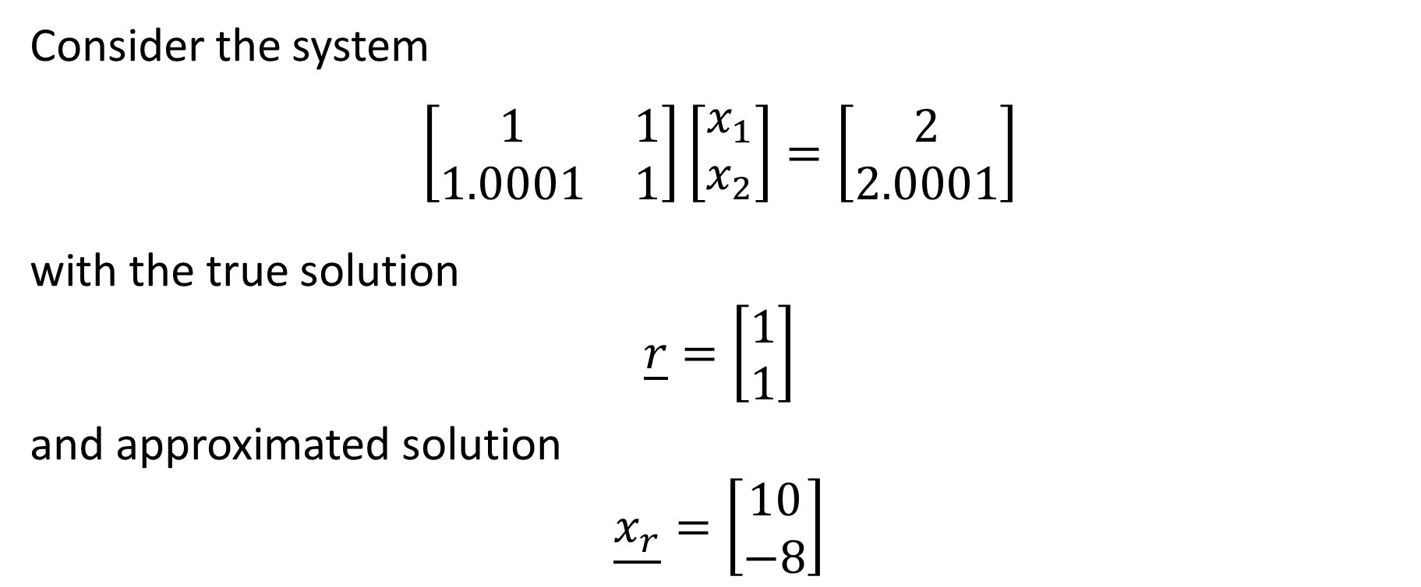
Example
Consider the system
$$\left[\begin{matrix}1 & 1 \\ 1.0001 & 1\end{matrix}\right]\left[\begin{matrix}x_{1} \\ x_{2}\end{matrix}\right]=\left[\begin{matrix}2 \\ 2.0001\end{matrix}\right]$$
with the true solution
$$\underline{r}=\left[\begin{matrix}1 \\ 1\end{matrix}\right]$$
and approximated solution
$$\underline{x_{r}}=\left[\begin{matrix}10 \\ −8\end{matrix}\right]$$
Notes:
Let us consider the displayed system
This system has an exact solution r which is the vector 1 1
Imagine we found an approximated solution xr equal to the vector 10 -8.
You can already tell that xr is quite far away from the true solution r.
Let us confirm this by computing the forward error.

Slide 4
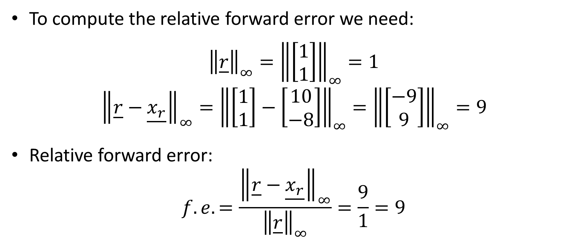
Example
To compute the relative forward error we need:
$${\left\|\underline{r}\right\|}_{∞}={\left\|\left[\begin{matrix}1 \\ 1\end{matrix}\right]\right\|}_{∞}=1$$
$${\left\|\underline{r}−\underline{x_{r}}\right\|}_{∞}={\left\|\left[\begin{matrix}1 \\ 1\end{matrix}\right]−\left[\begin{matrix}10 \\ −8\end{matrix}\right]\right\|}_{∞}={\left\|\left[\begin{matrix}−9 \\ 9\end{matrix}\right]\right\|}_{∞}=9$$
Relative forward error:
$$f.e.=\frac{{\left\|\underline{r}−\underline{x_{r}}\right\|}_{∞}}{{\left\|\underline{r}\right\|}_{∞}}=\frac{9}{1}=9$$
Notes:
To compute the relative forward error we compute
the infinity norm of the true solution r
And the infinity norm of the difference between the exact and approximated solution
This leads us to a relative forward error of 9, which confirms indeed that the approximation is rather poor.

Slide 5
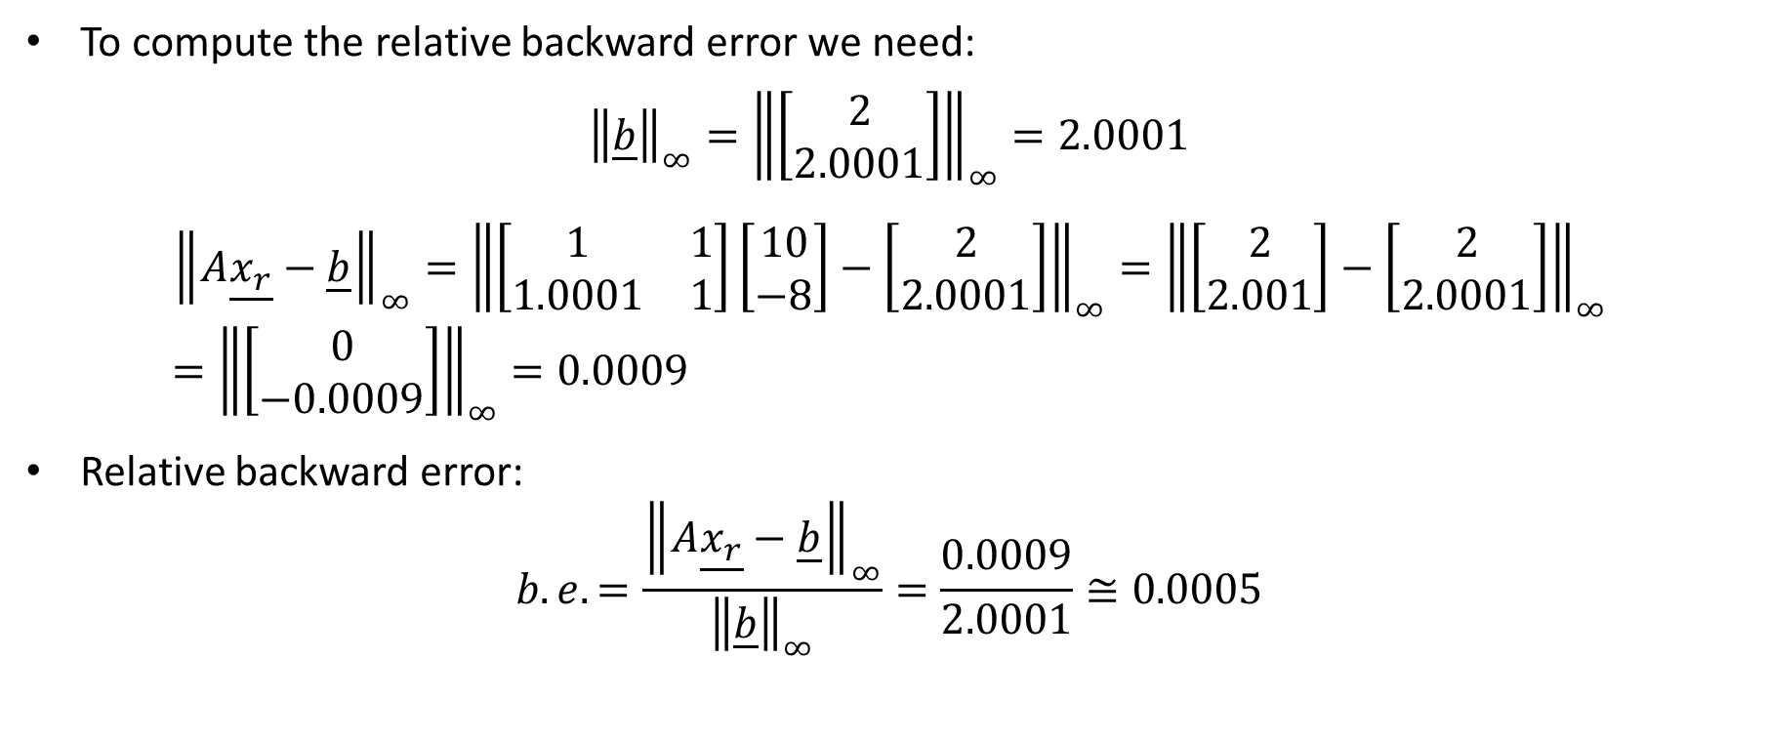
Example
To compute the relative backward error we need:
$${\left\|\underline{b}\right\|}_{∞}={\left\|\left[\begin{matrix}2 \\ 2.0001\end{matrix}\right]\right\|}_{∞}=2.0001$$
$${\left\|A\underline{x_{r}}−\underline{b}\right\|}_{∞}={\left\|\left[\begin{matrix}1 & 1 \\ 1.0001 & 1\end{matrix}\right]\left[\begin{matrix}10 \\ −8\end{matrix}\right]−\left[\begin{matrix}2 \\ 2.0001\end{matrix}\right]\right\|}_{∞}={\left\|\left[\begin{matrix}2 \\ 2.001\end{matrix}\right]−\left[\begin{matrix}2 \\ 2.0001\end{matrix}\right]\right\|}_{∞}={\left\|\left[\begin{matrix}0 \\ −0.0009\end{matrix}\right]\right\|}_{∞}=0.0009$$
Relative backward error:
$$b.e.=\frac{{\left\|A\underline{x_{r}}−\underline{b}\right\|}_{∞}}{{\left\|\underline{b}\right\|}_{∞}}=\frac{0.0009}{2.0001}≅0.0005$$
Notes:
But what about the backward error?
Will the backward error be large too?
To compute the relative backward error we compute progressively the infinity norm of
the right hand side vector b
and the difference between Ax and b.
This leads us to a very small relative backward error of 0.0005
This very small backward errors comes from the fact that if we plug back our approximation xr into the system, we almost satisfy the equations.
Indeed calculating A times xr yields the vector 2 2.001.
That is almost the right hand side vector b which is 2 2.0001

Slide 6
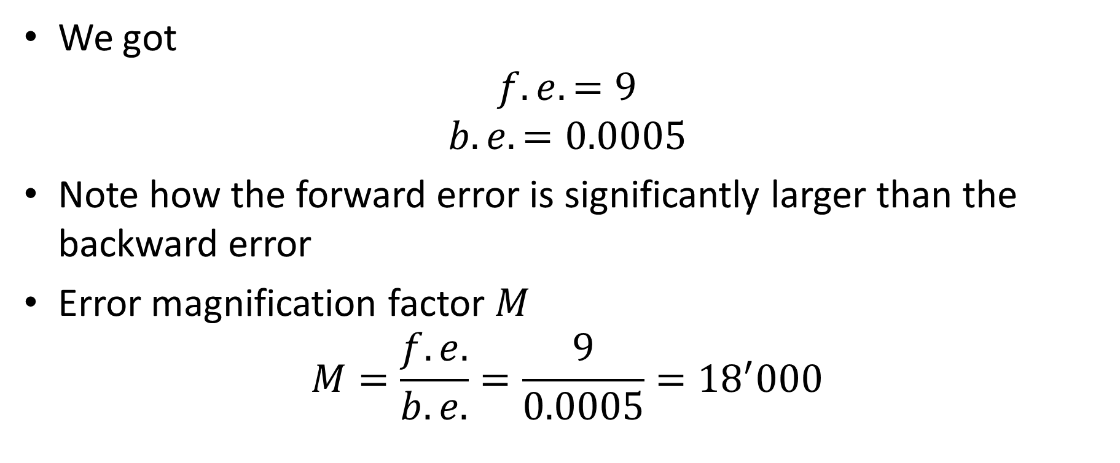
Example
We got
$$f.e.=9$$
$$b.e.=0.0005$$
Note how the forward error is significantly larger than the backward error
Error magnification factor $M$
$$M=\frac{f.e.}{b.e.}=\frac{9}{0.0005}={18}^{′}000$$
Notes:
Let us summarize our findings.
We got a relative forward error of 9 and a relative backward error of 0.0005
This are very different order of magnitudes. The forward error is much larger than the backward error
Recall that the backward error is the only error you have access to.
It is the error you get by plugging back your approximation into the original problem
In the example, if you take the approximation xr and plug it into the system you want to solve, you find that the equations are almost satisfied.
Only a very small discrepancy exists.
But in fact the approximation is very far away from the exact solution r.
This behavior is exemplified by the very larger error magnification factor of 18’000.
Why do we have such a strange behavior?
Why our equations are almost satisfied even that our approximation is very far away from the actual solution?

Slide 7
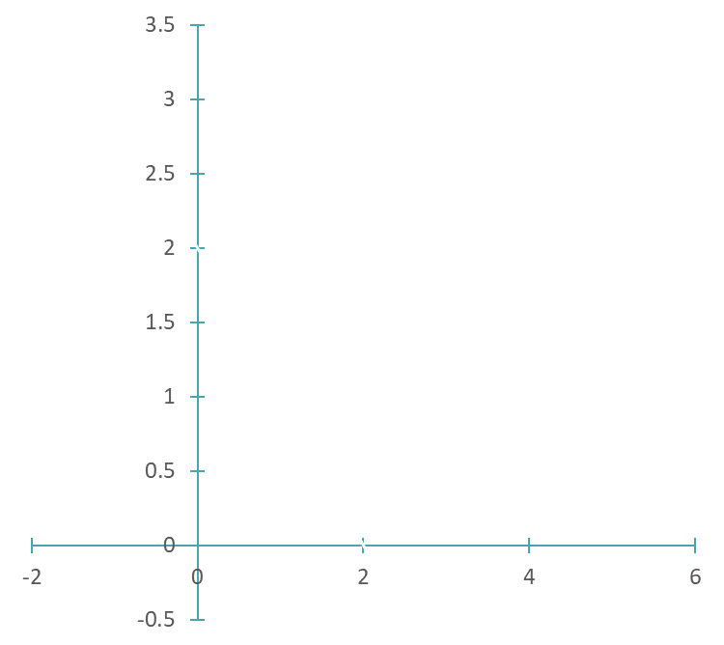




Example
$$x_{2}$$
$${1.0001x}_{1}+x_{2}=2.0001$$
Both equations nearly identical
$$x_{1}+x_{2}=2$$
$$x_{1}$$
Notes:
A graph answers this question
Let us plot our two equations in the x1 x2 plane
Let us start with the first equation x1+x2 = 2
We get the line as shown
Let us now plot the second equation ${1.0001x}_{1}+x_{2}=2.0001$
We can not discern any difference.
Both equations are very similar: in fact almost identical.
This explains why we can almost satisfy them even when not using the correct solution.
As long as we use an approximation xr which is near one of the two equations we will always almost satisfy the second one too.
Such as situation is a case of an ill-conditioned problem.
It is analog to the case of flat functions we discussed for nonlinear equations

Slide 8

Predicting the Error Magnification Factor
For linear systems one can compute the to be expected error magnification factor
Theorem
The largest to be expected error magnification factor when solving a linear system of equations $A\underline{x}=\underline{b}$ is given by:
$$\text{cond}\left(A\right)={\left\|A\right\|}_{∞}∙{\left\|A^{−1}\right\|}_{∞}$$
Notes:
The good news is that contrary to nonlinear equations, for linear equations we can compute the error magnification factor.
There is an important theorem that reads as:
The largest to be expected error magnification factor when solving a linear system of equations $A\underline{x}=\underline{b}$ is given by the conditioning number of the coefficient matrix A.
The conditioning number of the coefficient matrix can be calculated by multiplying the infinity norm of the A with the infinity norm of the inverse of A
Luckily this is simple to do as we will see.
Of course, if you want to be able to use this theorem you need to know how to compute the infinity norm of a matrix.

Slide 9






Matrix Norm
Definition
The infinity norm of a matrix $A$ is defined as:
$${\left\|A\right\|}_{∞}=\text{maximum} \text{absolute} \text{row} \text{sum}$$
Example
$$7$$
$${\left\|\left[\begin{matrix}3 & 2 & 2 \\ −2 & −7 & 4 \\ 4 & 1 & −3\end{matrix}\right]\right\|}_{∞}$$
$$13$$
$$=13$$
$$8$$
Notes:
The infinity norm of a matrix $A$ is defined as the maximum absolute row sum
For example for the matrix displayed one proceeds as follows
First we compute the sum in absolute value of the first row.
We obtain 7 in our example
Second we compute the sum in absolute value of the second row.
We obtain 13 in our example
And third we compute the sum in absolute value of the third row.
We obtain 8.
Now we look for the largest row sum
This is 13, the row sum of the second row.
Consequently the infinity norm of our matrix is 13

Slide 10

Matlab / Octave
Matlab / Octave has a function to compute matrix norms which has the same syntax as `vector norms.
$$\left[\begin{matrix}3 & 2 & 2 \\ −2 & −7 & 4 \\ 4 & 1 & −3\end{matrix}\right]$$
octave> A=[3 2 2; -2 -7 4; 4 1 -3];
octave> norm(A,inf)
ans = 13
Notes:
Matlab, respectively octave, has a function to compute matrix norms which has the same syntax as `vector norms
Let us illustrate this for computing the matrix norm of our matrix used previously
First we enter the matrix into the variable A
The we execute the command norm(A,inf) to compute the infinity norm of the matrix
As expected we get 13 as answer

Slide 11
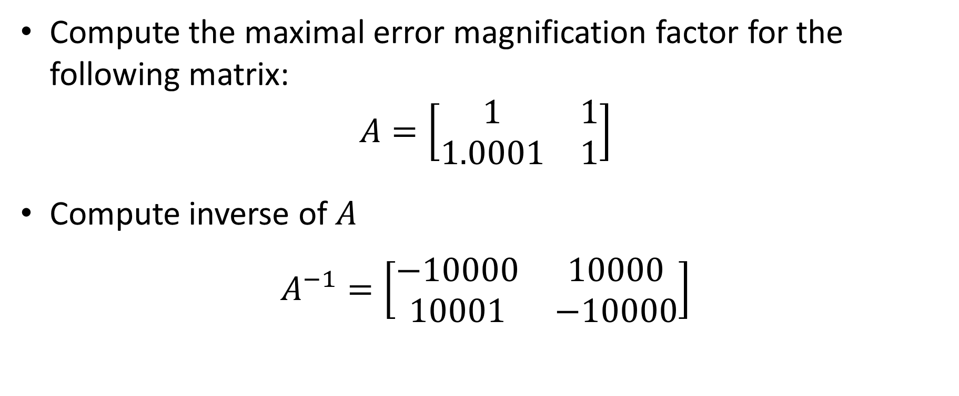
Example
Compute the maximal error magnification factor for the following matrix:
$$A=\left[\begin{matrix}1 & 1 \\ 1.0001 & 1\end{matrix}\right]$$
Compute inverse of $A$
$$A^{−1}=\left[\begin{matrix}−10000 & 10000 \\ 10001 & −10000\end{matrix}\right]$$
Notes:
Let us use our freshly learned theorem in our introductory example
The system we considered had the displayed coefficient matrix A
The inverse of A can be computed and equals to the matrix shown
Indeed for two by two matrices, the inverse is fairly easy to obtain
For larger matrices this is much more involved.
But, even if we don’t see them in this semester, there exist numerical algorithms which can compute quite efficiently the inverse of matrices.

Slide 12
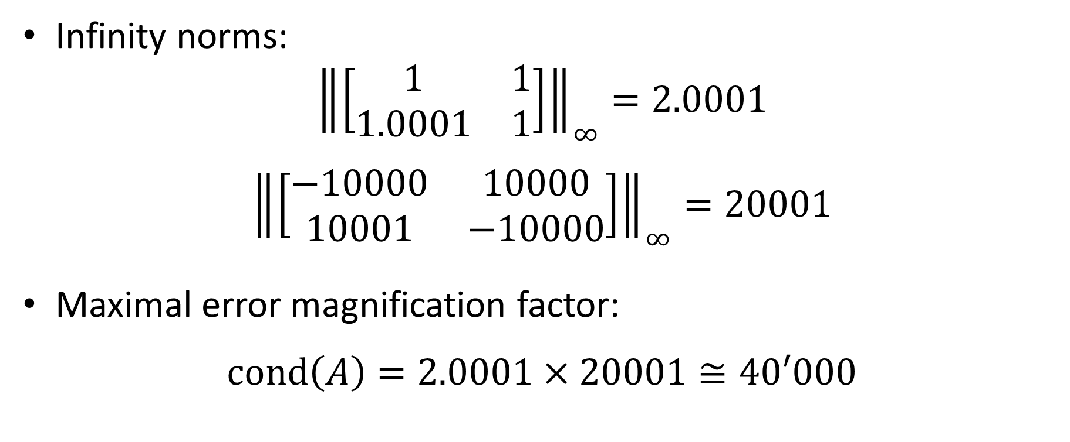
Example
Infinity norms:
$${\left\|\left[\begin{matrix}1 & 1 \\ 1.0001 & 1\end{matrix}\right]\right\|}_{∞}=2.0001$$
$${\left\|\left[\begin{matrix}−10000 & 10000 \\ 10001 & −10000\end{matrix}\right]\right\|}_{∞}=20001$$
Maximal error magnification factor:
$$\text{cond}\left(A\right)=2.0001×20001≅40′000$$
Notes:
Having our matrices A and its inverse we can compute their infinity norms
For A we get about 2 whereas for its inverse we get about 20’000
Consequently the conditioning number, which is the biggest error magnification factor we can expect when solving a system involving this coefficient matrix,
Is about 40’000
In the particular example we considered previously we found an error magnification factor of 18’000. That is indeed smaller than the conditioning number as stated by our theorem.
The theorem considers the worst case situation and in that sense is rather pessimistic.
But that is perfectly acceptable for numerical methods.
We always want conservative estimates.

Slide 13
Using Octave/Matlab
The Matlab/Octave command “cond” computes the conditioning number of a matrix. The first parameter is the matrix and the second is the type of vector norm one wants to use.
Example:
octave> A = [1 1; 1.0001 1];
octave> cond(A,inf)
ans = 40004.00010
Notes:
Matlab and octave have a function to compute conditioning numbers
The command is cond which takes two parameters.
The first one is the matrix
The second one is the type of norm you want to use.
Let us do an example
We start by defining a matrix A.
To compute the conditioning number of A using the infinity norm we use the command cond(A, inf)
Executing it gives us the expected answer which is the same as we obtained on our calculations.

Slide 14
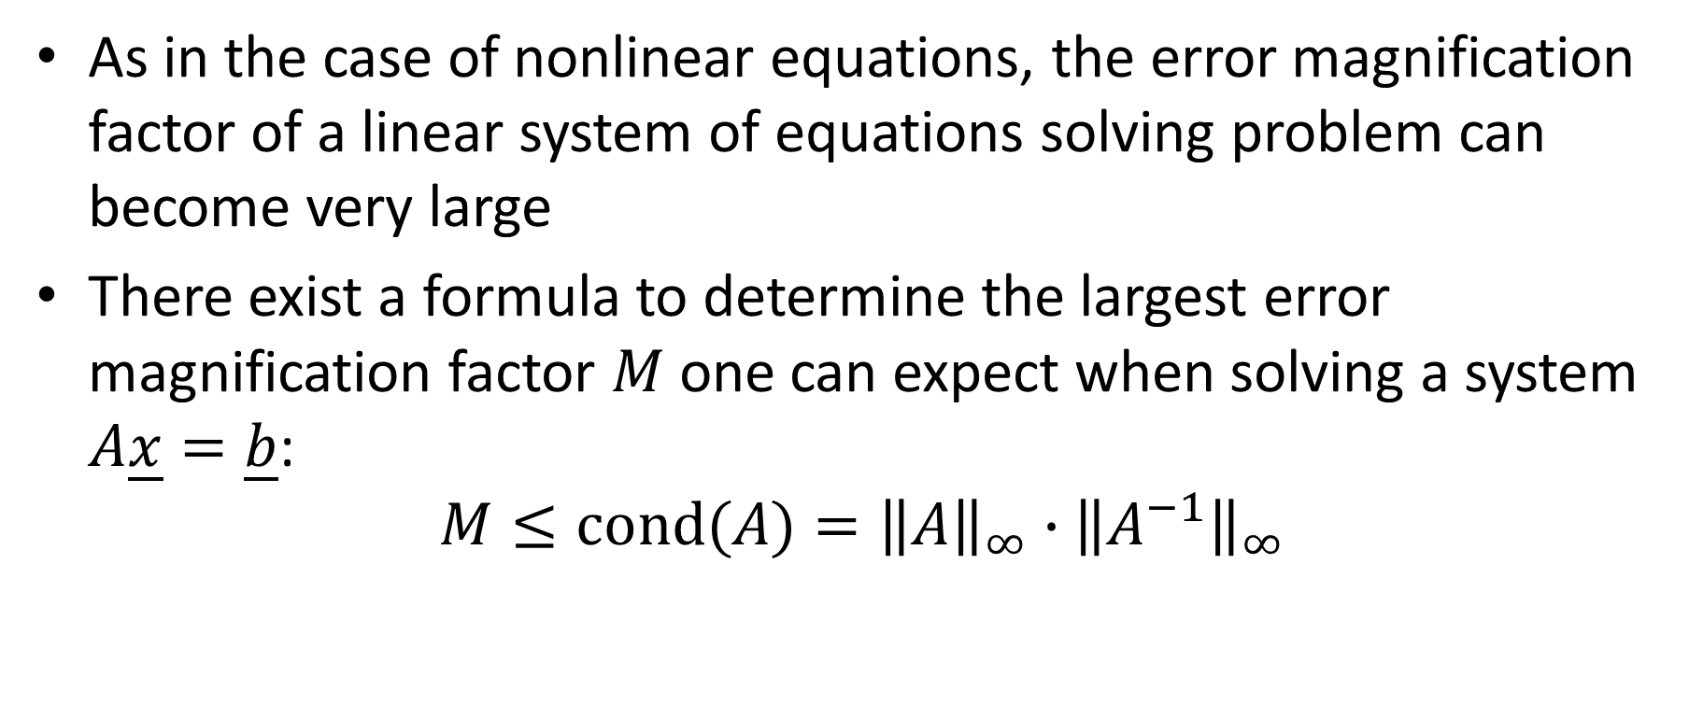
Summary
As in the case of nonlinear equations, the error magnification factor of a linear system of equations solving problem can become very large
There exist a formula to determine the largest error magnification factor $M$one can expect when solving a system $A\underline{x}=\underline{b}$:
$$M≤\text{cond}(A)={\left\|A\right\|}_{∞}∙{\left\|A^{−1}\right\|}_{∞}$$
Notes:
Let us summarize the key findings
As in the case of nonlinear equations, the error magnification factor of a linear system of equations solving problem can become very large
There exist a formula to determine the largest error magnification factor $M$one can expect when solving a system $A\underline{x}=\underline{b}$
The largest error magnification factor is the conditioning number of the coefficient matrix which is equal to the product
between the infinity norm of the A and the infinity norm of the inverse of A.

